Slide 1
Group 2
Group members:
Rado Vesely
Lana Sladovic
Paul Cheralu
Eliska Bernardova
Patrícia Gaspar

Slide 2
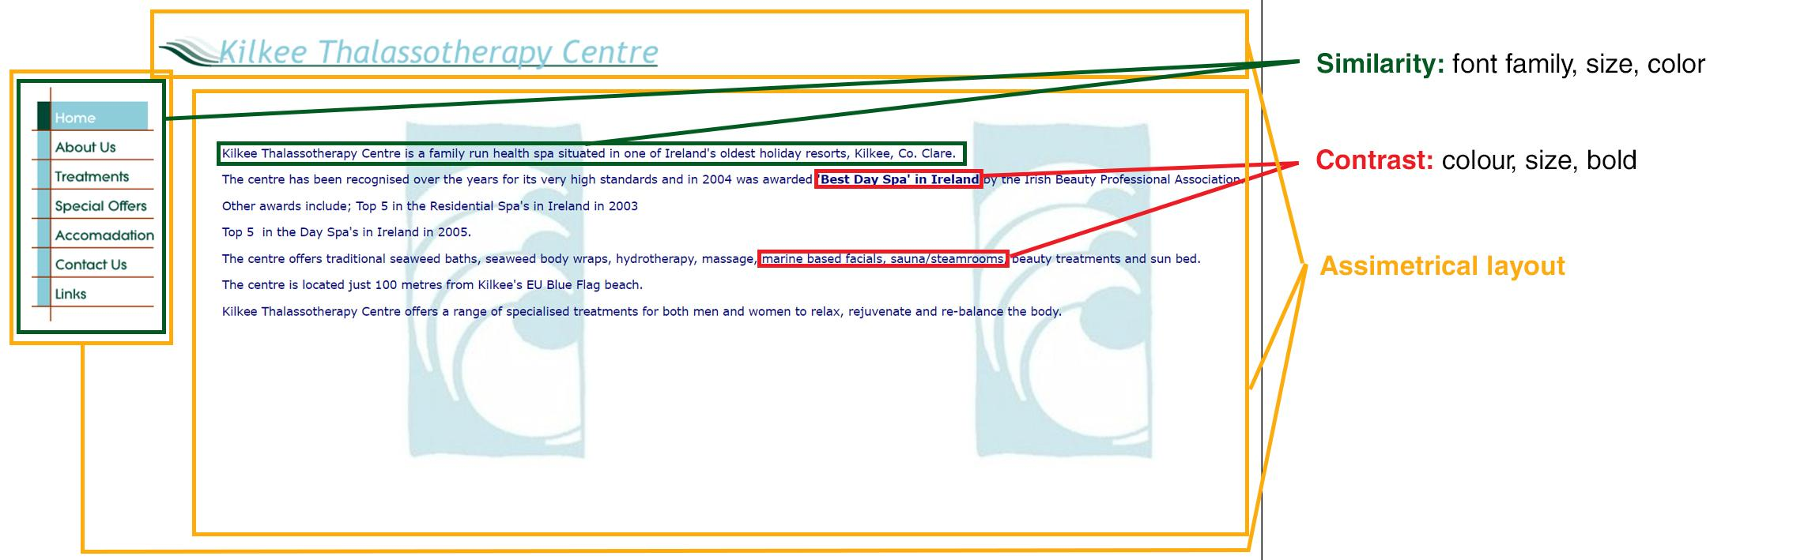
Design Principles (old version)
Link: http://www.kilkeethalasso.com

Slide 3
Test Report
It was practically impossible to remember the name of the site because of the bad composition of the page and the logo structure.
Users didn’t want to stay there more than 5 secs, because wasn’t visually well-arranged.

Slide 4

Moodboard

Slide 5
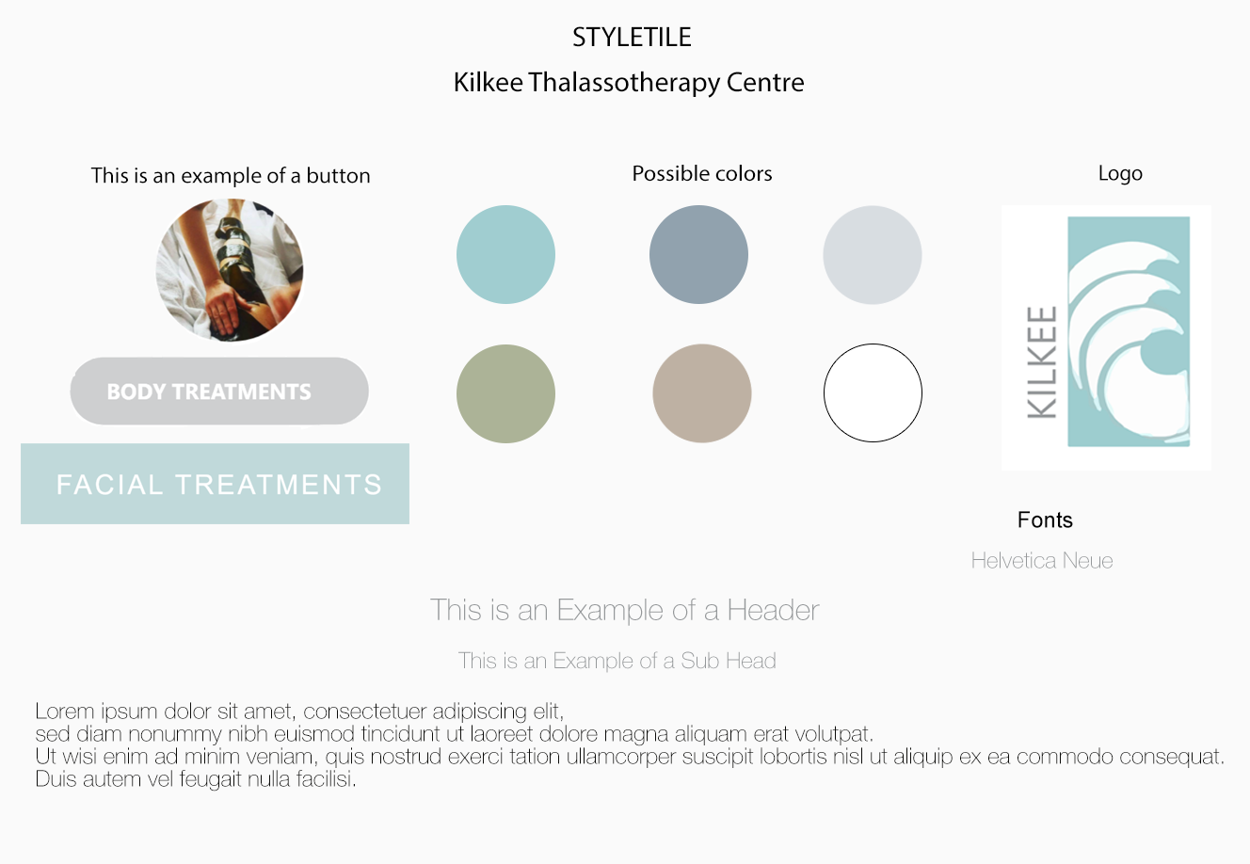
Style Tiles

Slide 6
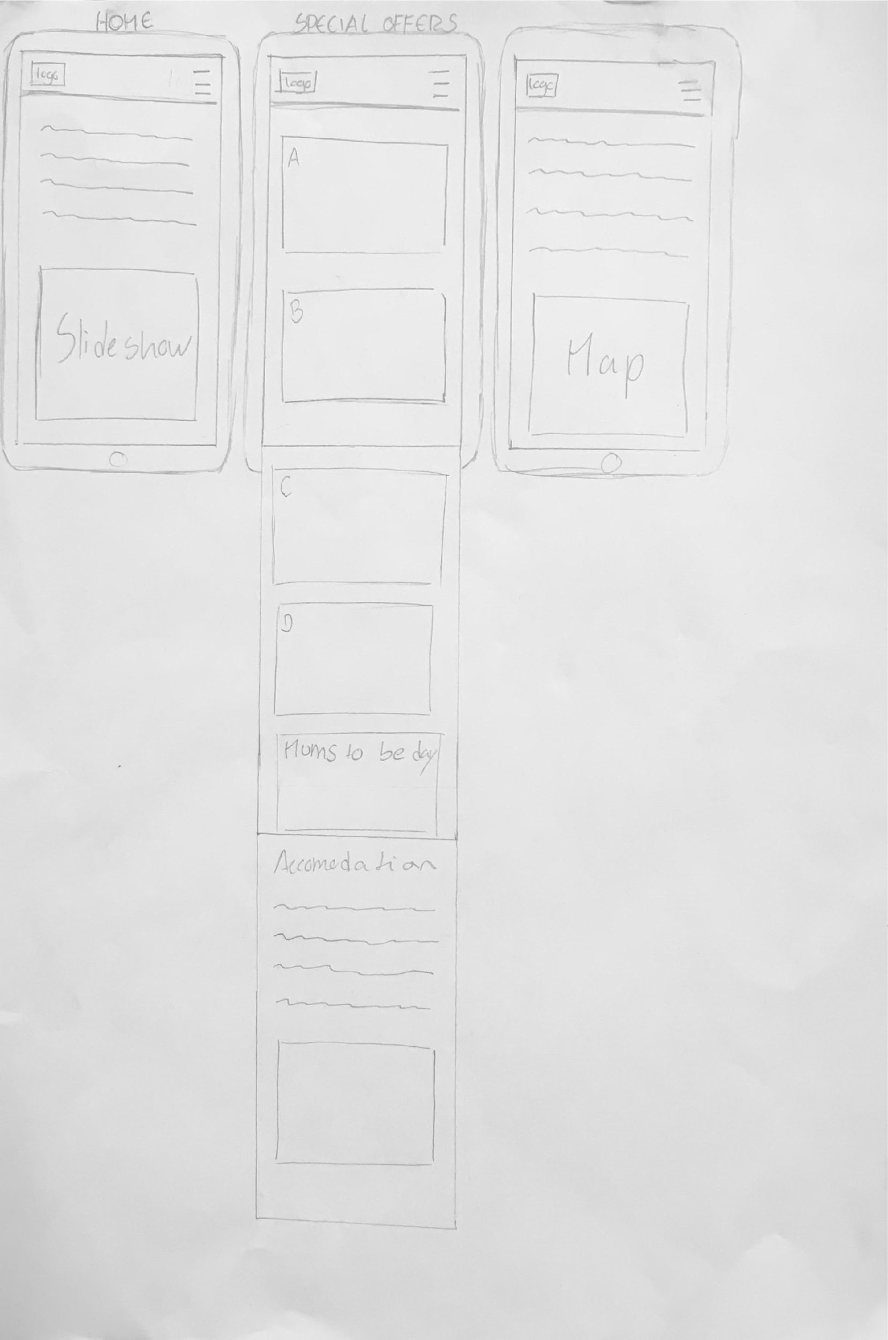
Mobile Paper Prototypes

Slide 7
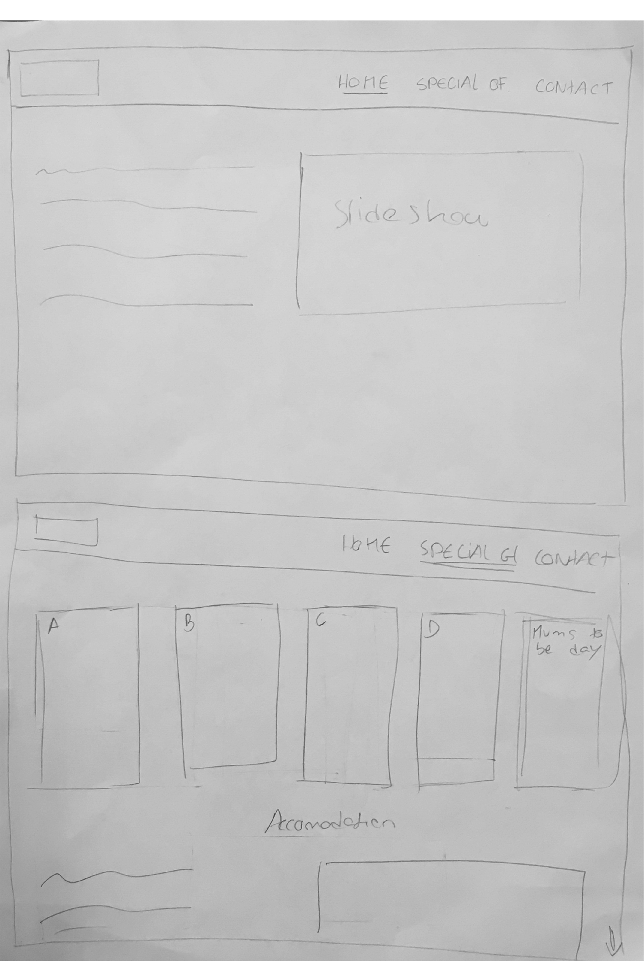
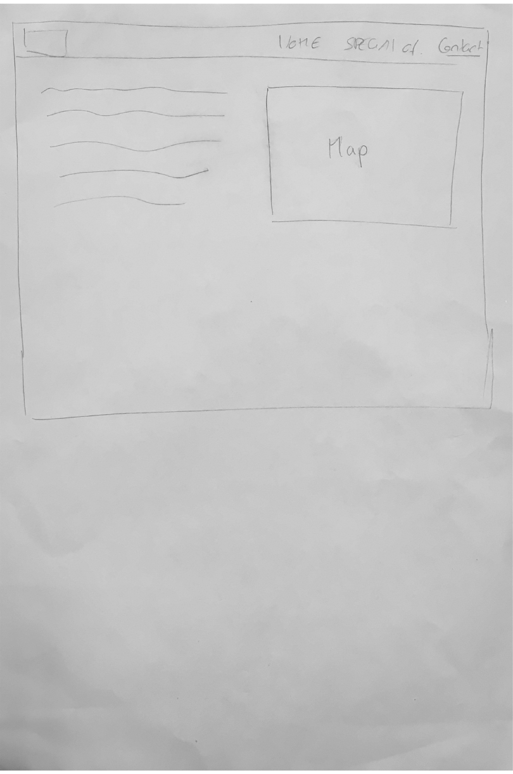
Desktop Paper Prototypes

Slide 8
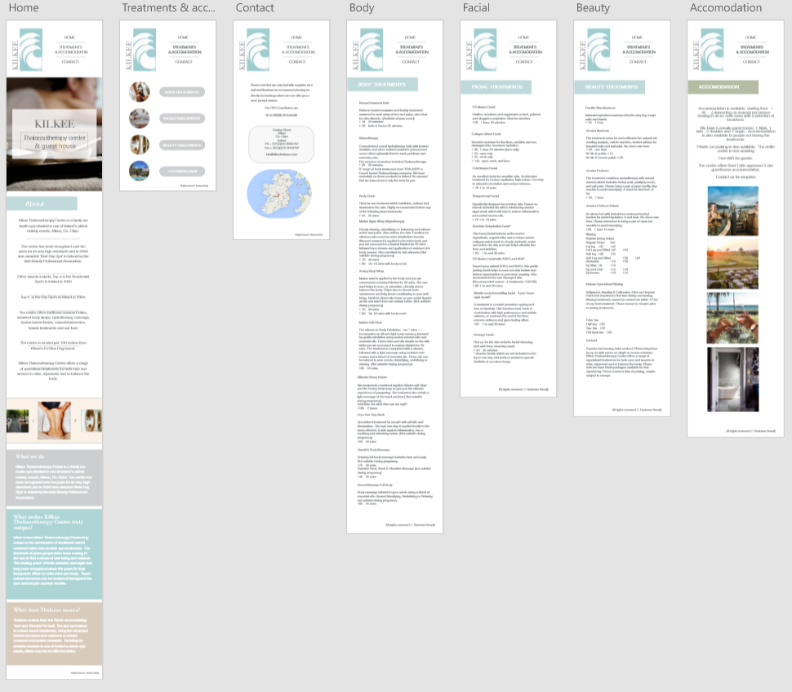
XD Mobile Prototype
Link: https://xd.adobe.com/view/dbf7aa31-828a-4410-9850-67c6025946b5

Slide 9
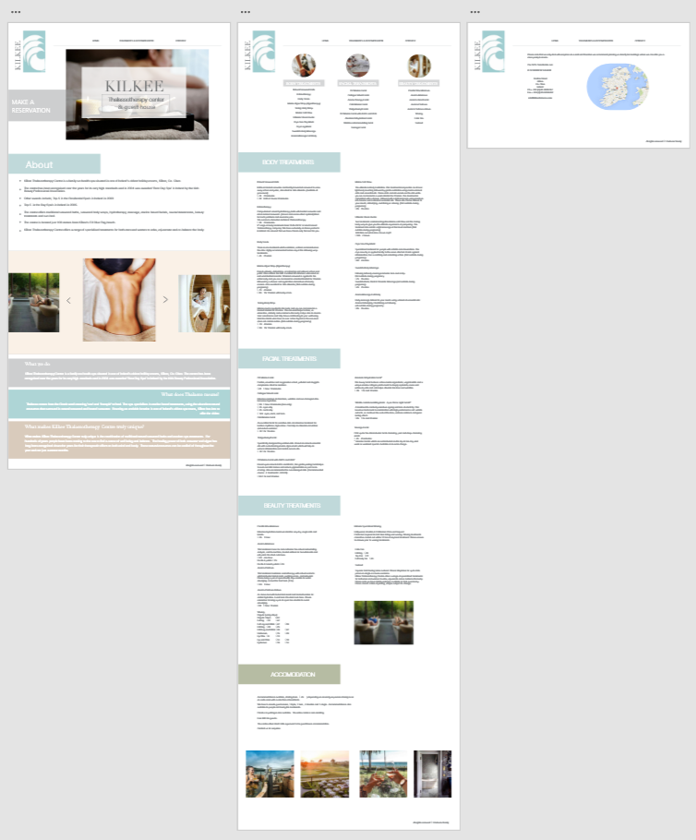
XD Desktop Prototype
Link:
https://xd.adobe.com/view/85384137-dc84-497d-949f-51557cc56787t

Slide 10
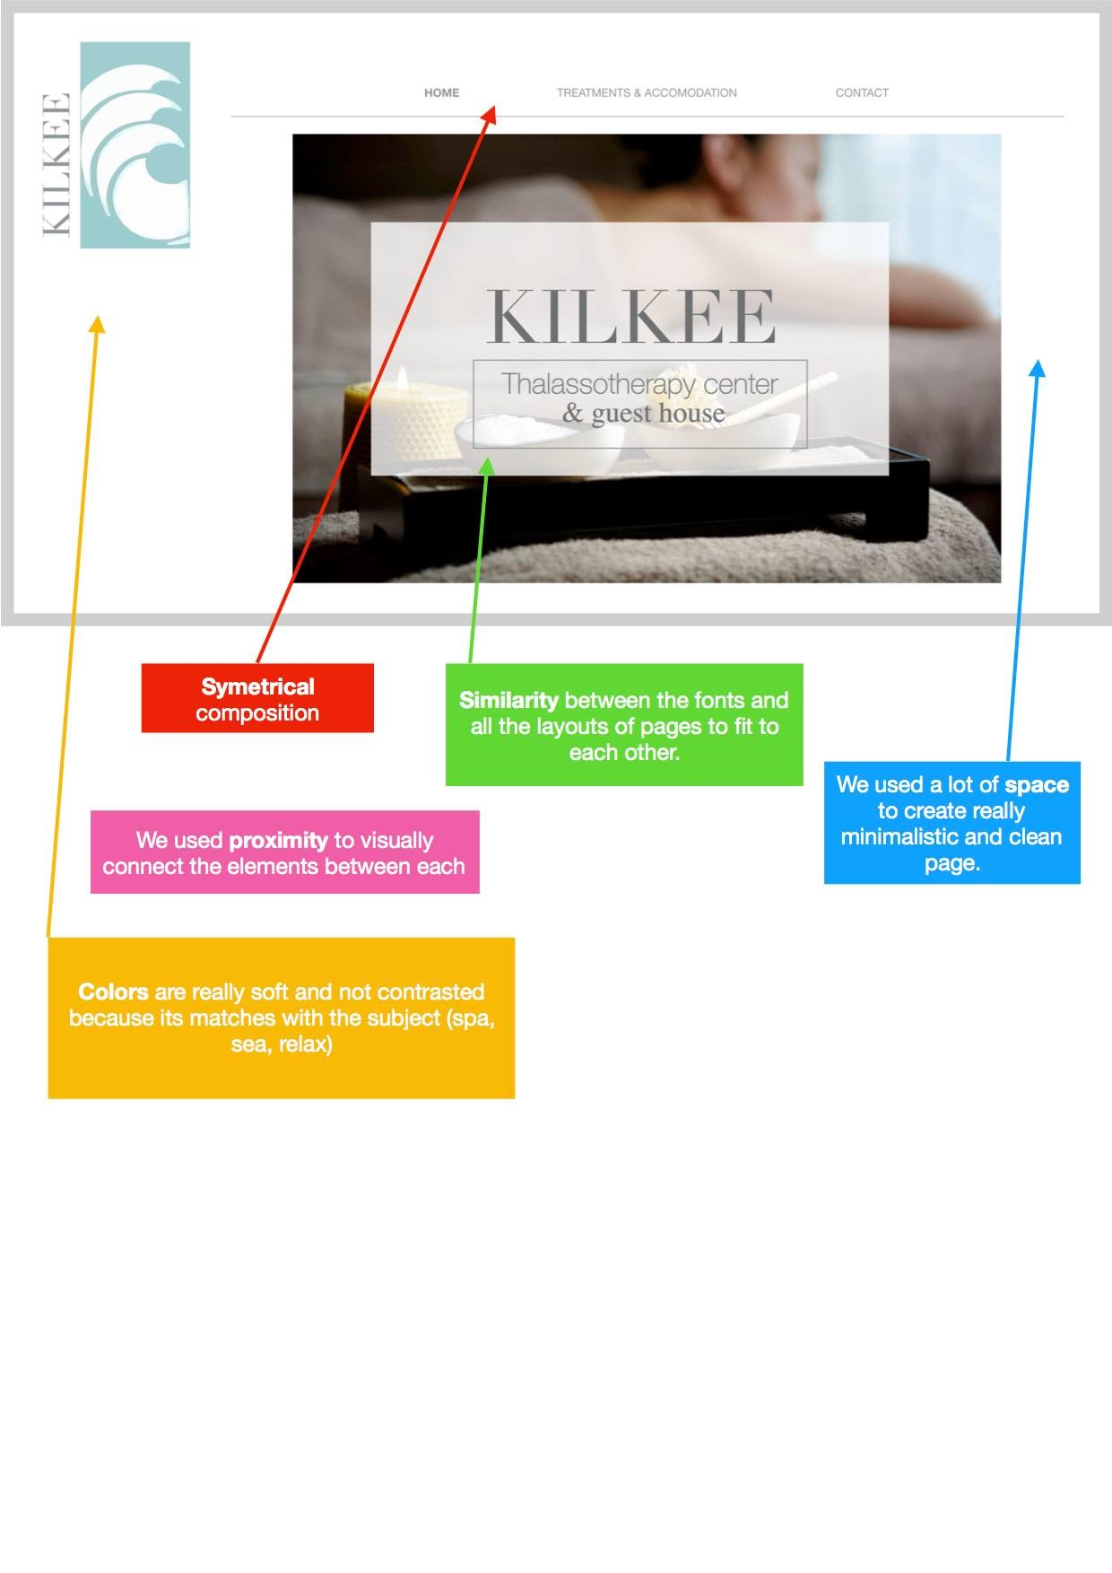
Design Principles
(new version)
Link: http://paulchelaru.com/sitee/home.html

Slide 11
Test results and changes
Navigation is easily visible and simple
Users can recognize that site is about Spa, health and therapy
- It is easy for users to remember the name of the company
they are no longer confused about booking the room or ordering a therapy .
Site is visually well-arranged and they would like to stay for longer time and that was our goal.
Test Report

Slide 12
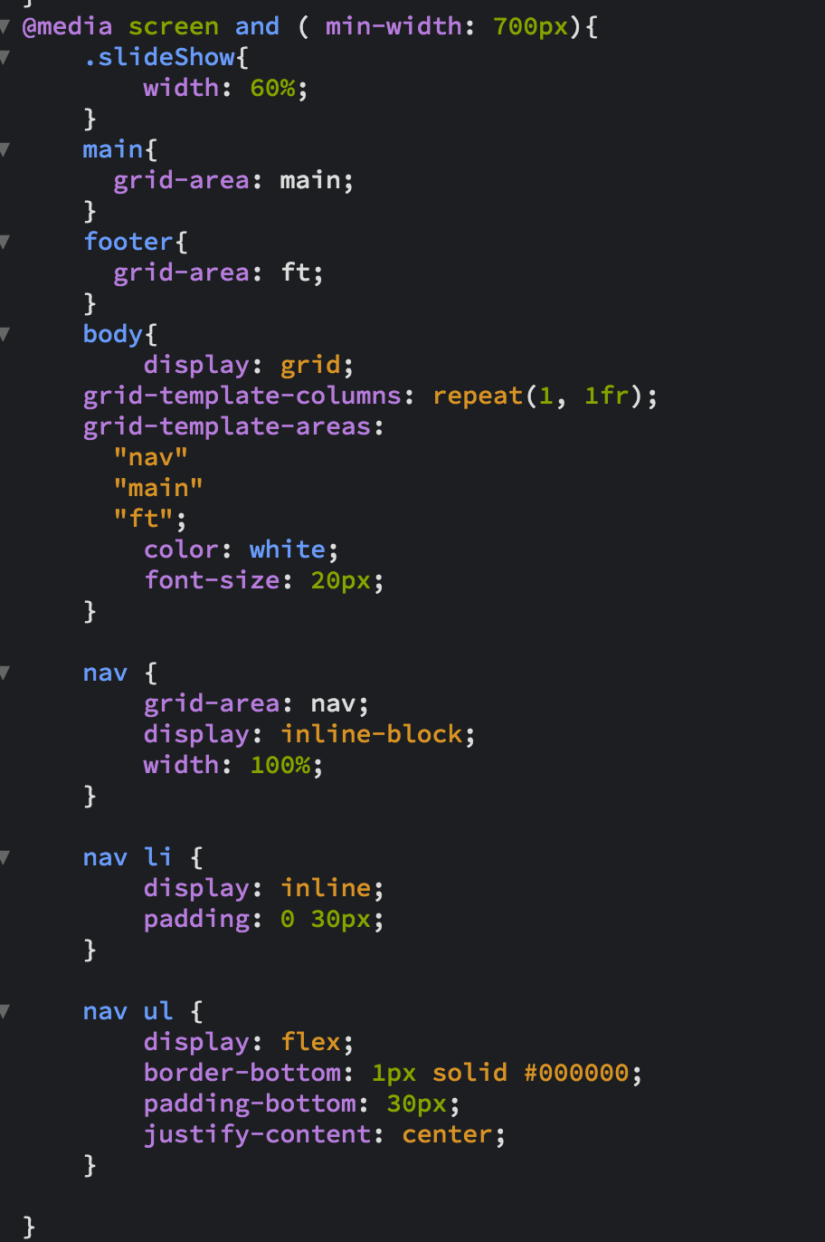
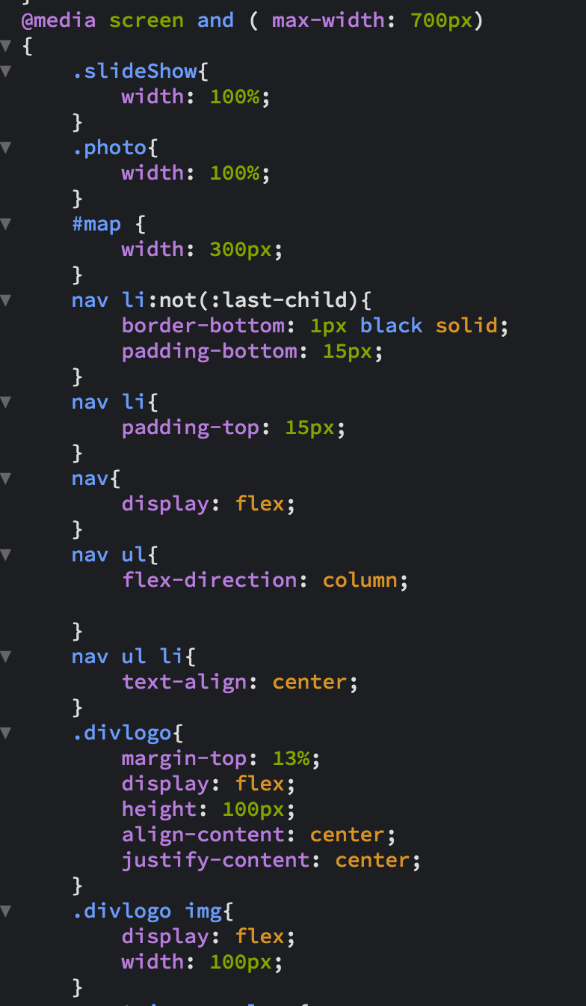
Code snippets of CSS in media queries

